Slide 1
U.S. International & Domestic Air Traffic Data
CIS 3200 Group 1
Abrar Hasan, Dante Villalobos, Jenny Iglesias, Roxana Cuevas

Slide 2
Analysis of Air Traffic Data
Contents
With this data set we will examine travel logs to determine:
Airports busiest and least busy time of year for international travel
Top busiest airports for international travel
Top busiest foreign airports receiving US passengers
Best time for international travel
Historical figures that show international travel trends

Slide 3
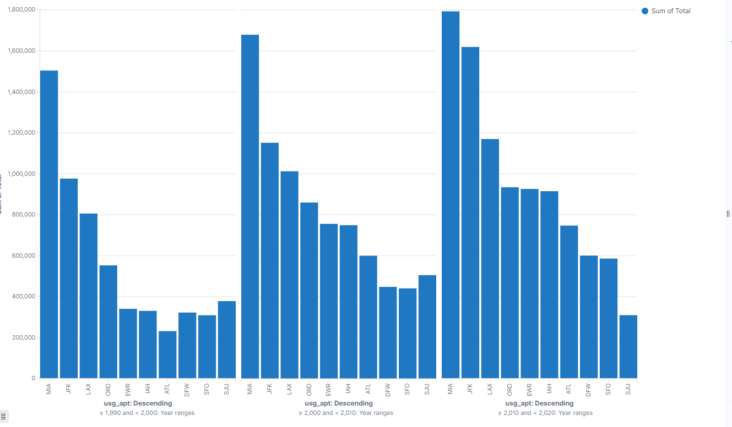
Top 10 busiest airports (departure)in the U.S. from 1990-2000 2000-2010 2010-2020

Slide 4
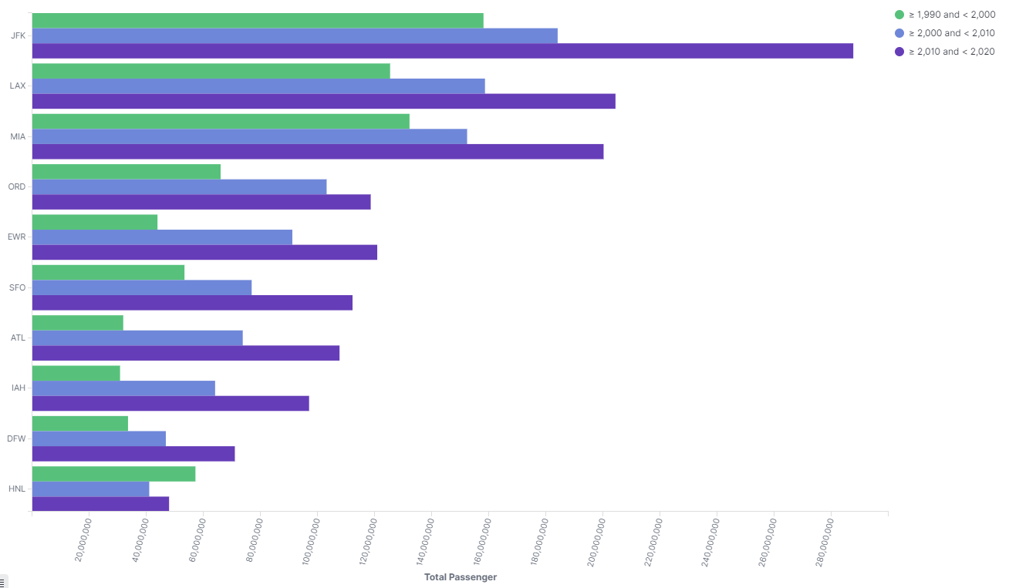
Top 10 busiest airports (Passengers)in the U.S. from 1990-2000 2000-2010 2010-2020

Slide 5
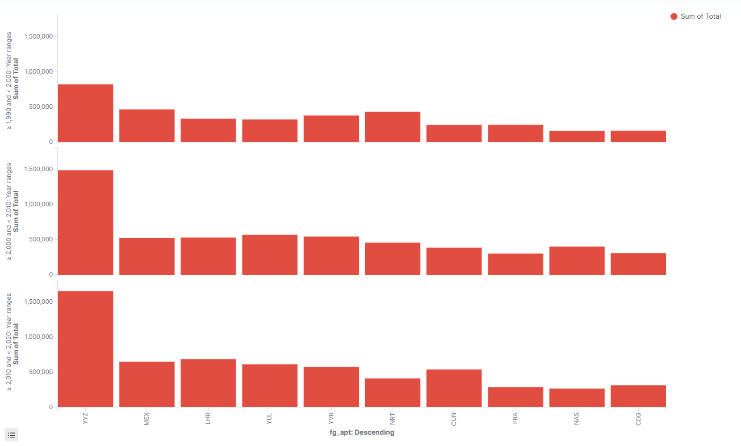
Top 10 busiest airports(Departure) in the World from 1990-2000 2000-2010 2010-2020

Slide 6
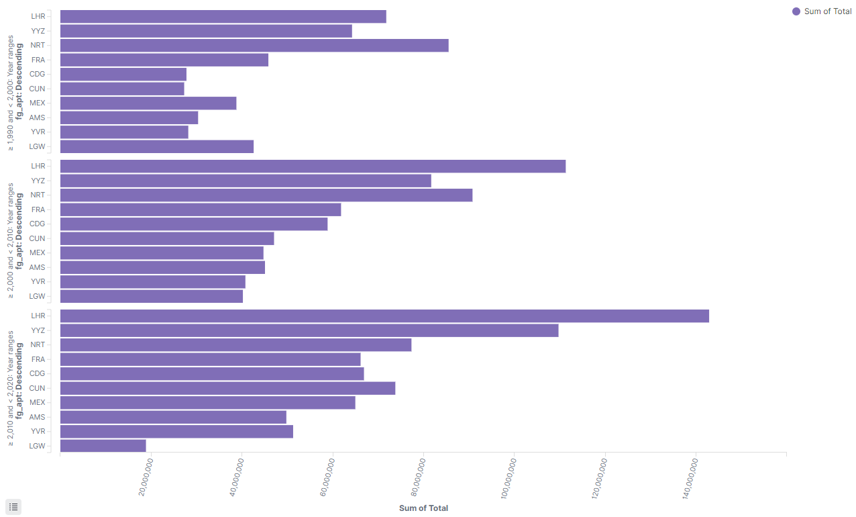
Top 10 busiest airports (Passengers)in the World from 1990-2000 2000-2010 2010-2020

Slide 7
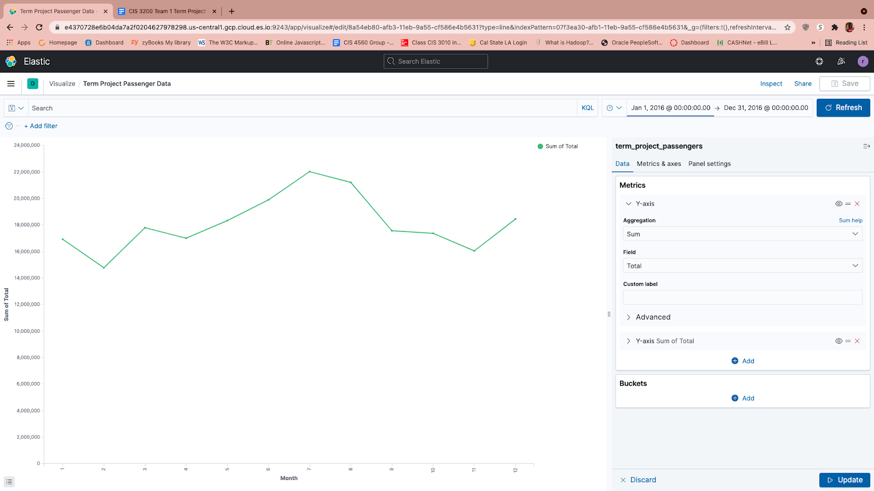
2016 Peak travel occurs in month 7 (22,029,902) Least busy travel occurs in month 2 (14,781,989)

Slide 8
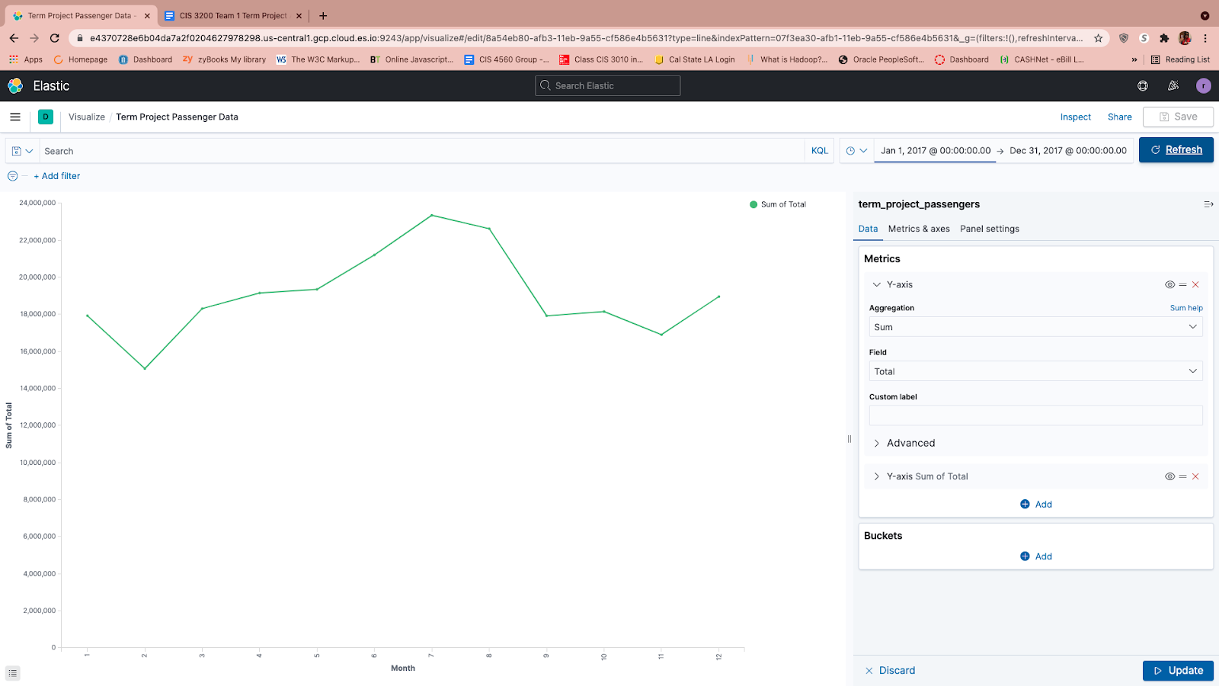
2017 Peak travel occurs in month 7 (23,350,538) Least busy travel occurs in month 2 (15,075,141)

Slide 9
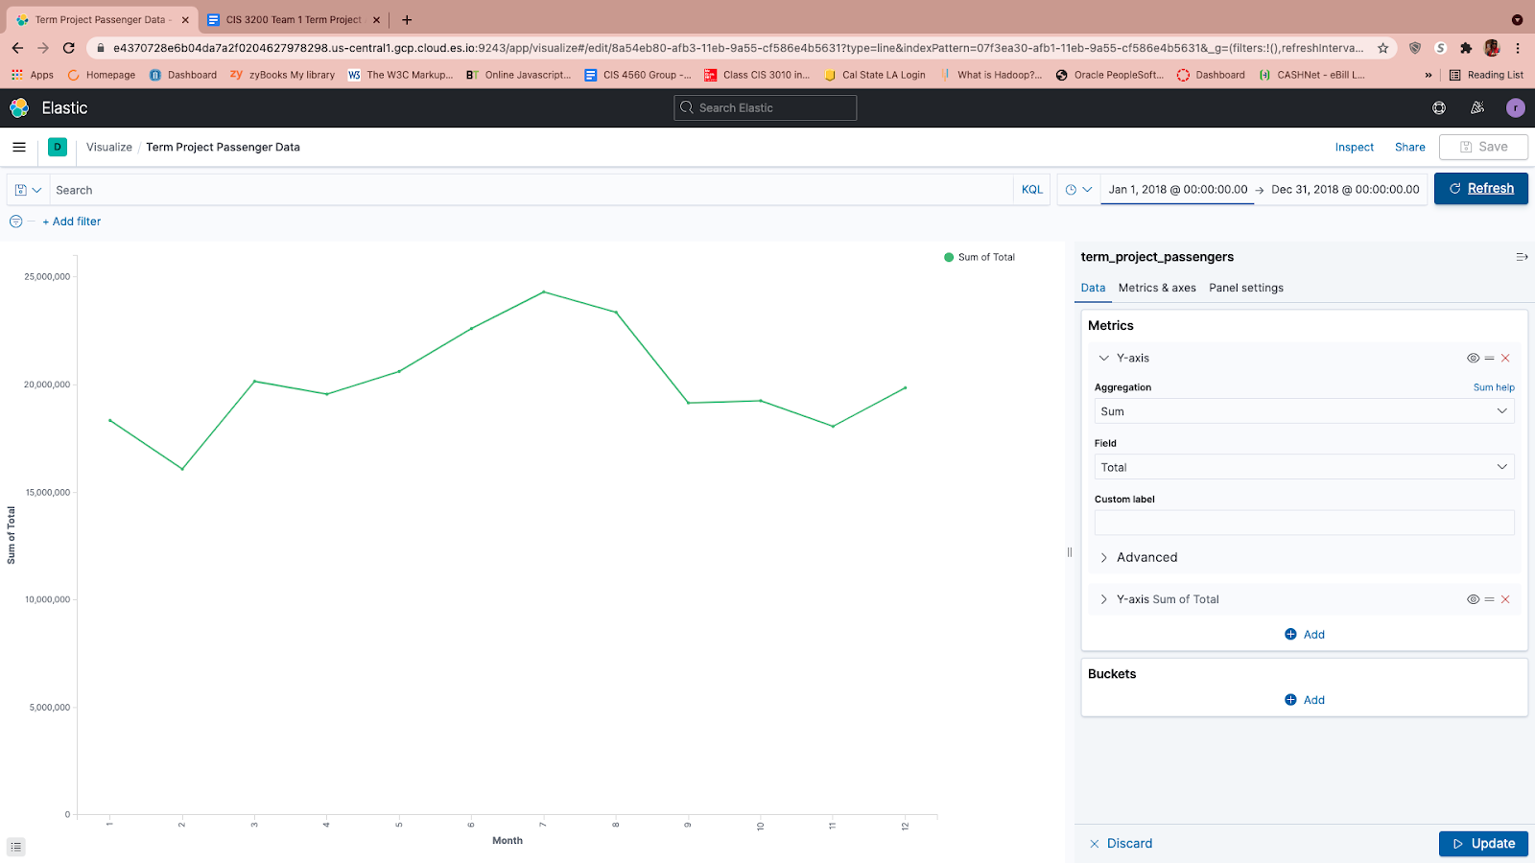
2018 peak travel occurs in month 7 (24,314,837) Least busy travel occurs in month 2 (16,082,295)

Slide 10
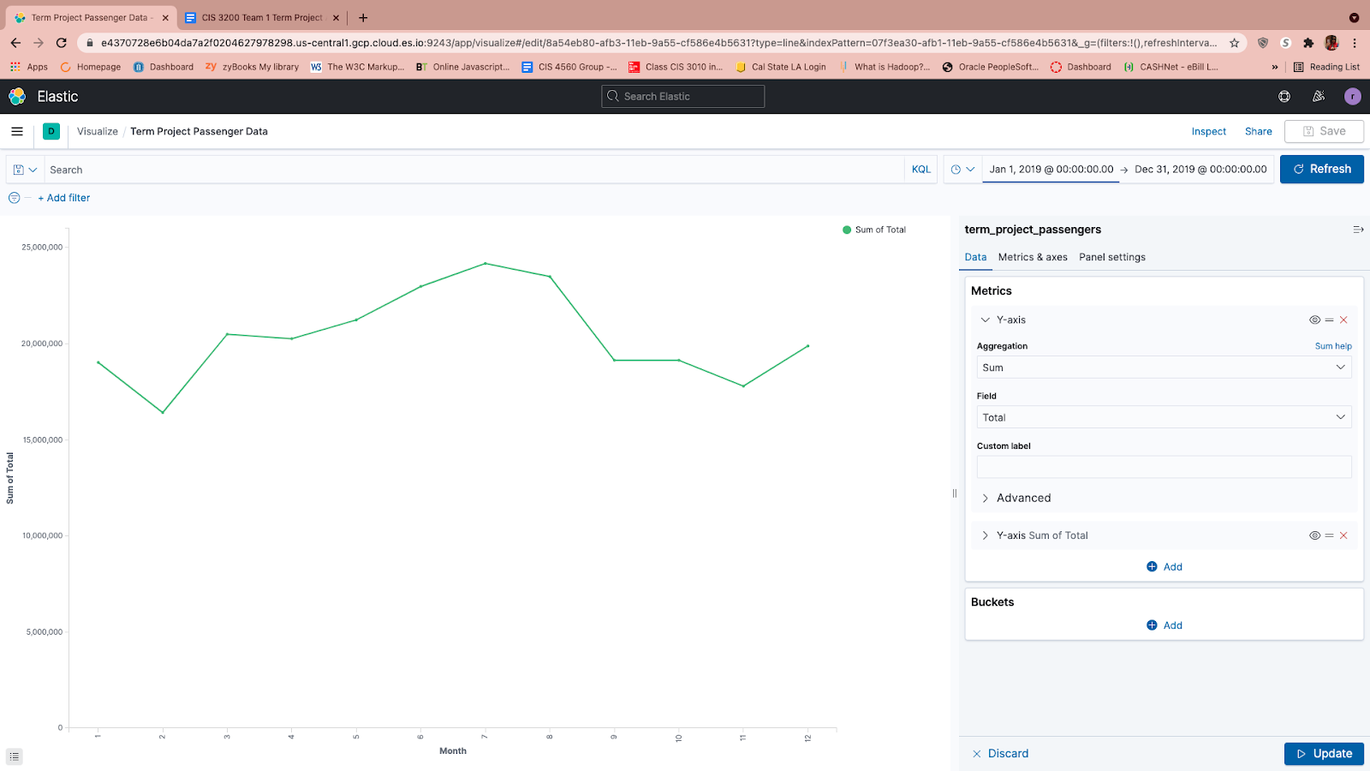
2019 Peak travel occurs in month 7 (24,177,588) Least busy travel occurs in month 2 (16,416,783)

Slide 11
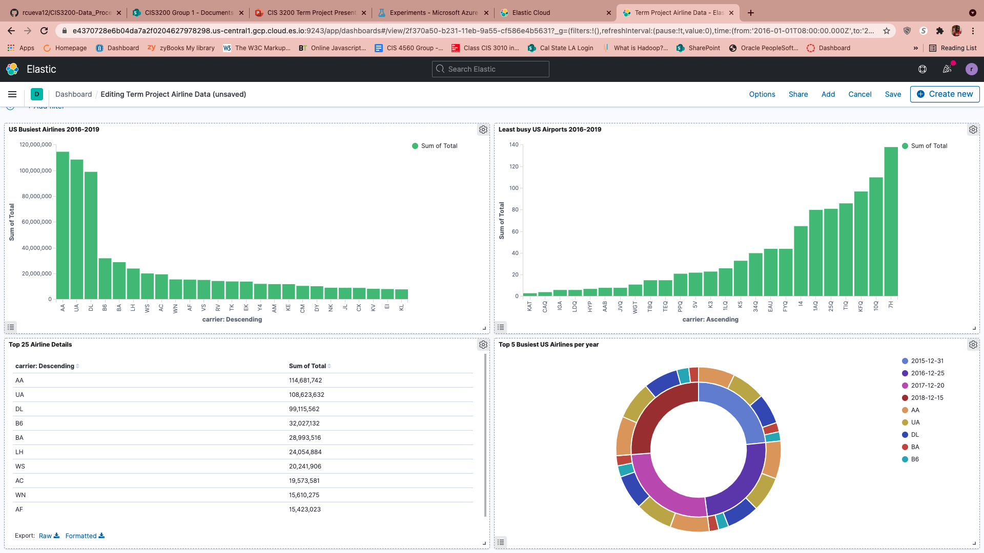
Busiest Airline Detail Dashboard

Slide 12
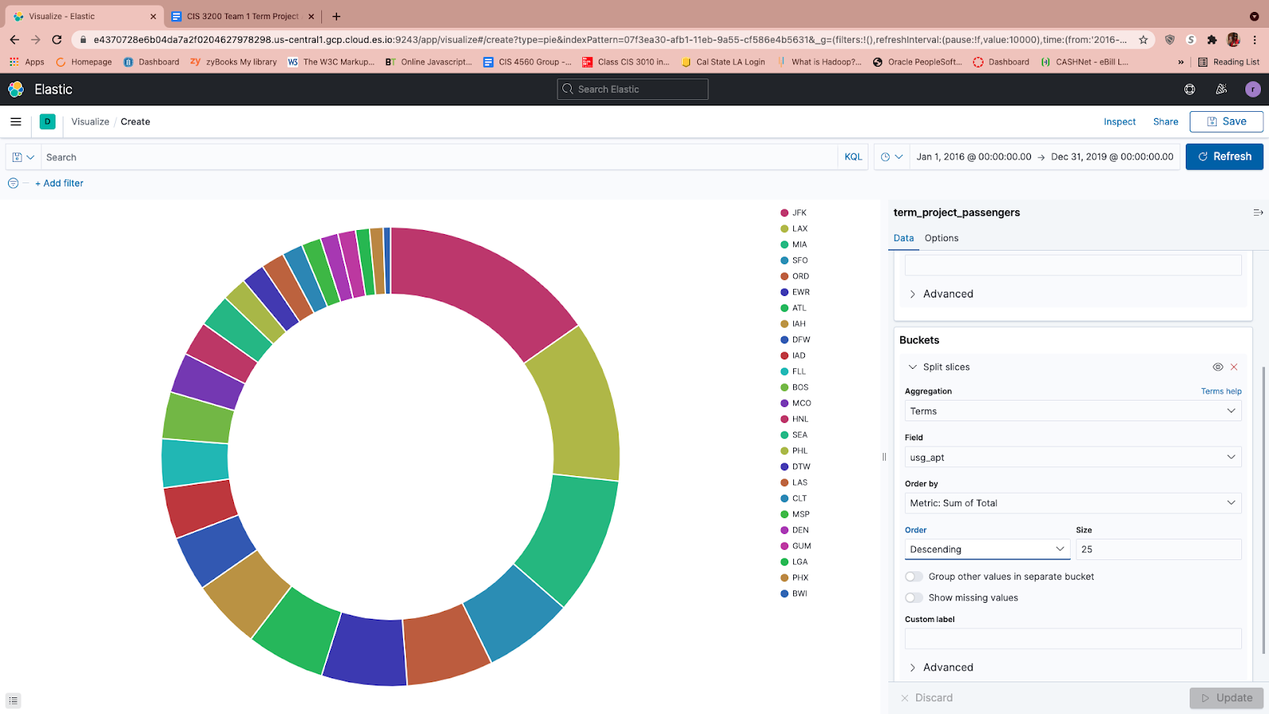
Drilldown Top 10 Fly From US Airports 2016-2019 JFK- New York, NY LAX- Los Angeles, CA MIA-Miami, FL SFO-San Francisco, CA ORD-Chicago, IL EWR-Newark, NJ ATL-Atlanta, GA IAH-Houston, TX DFD-Woburn, WA IAD-Dulles, VA

Slide 13
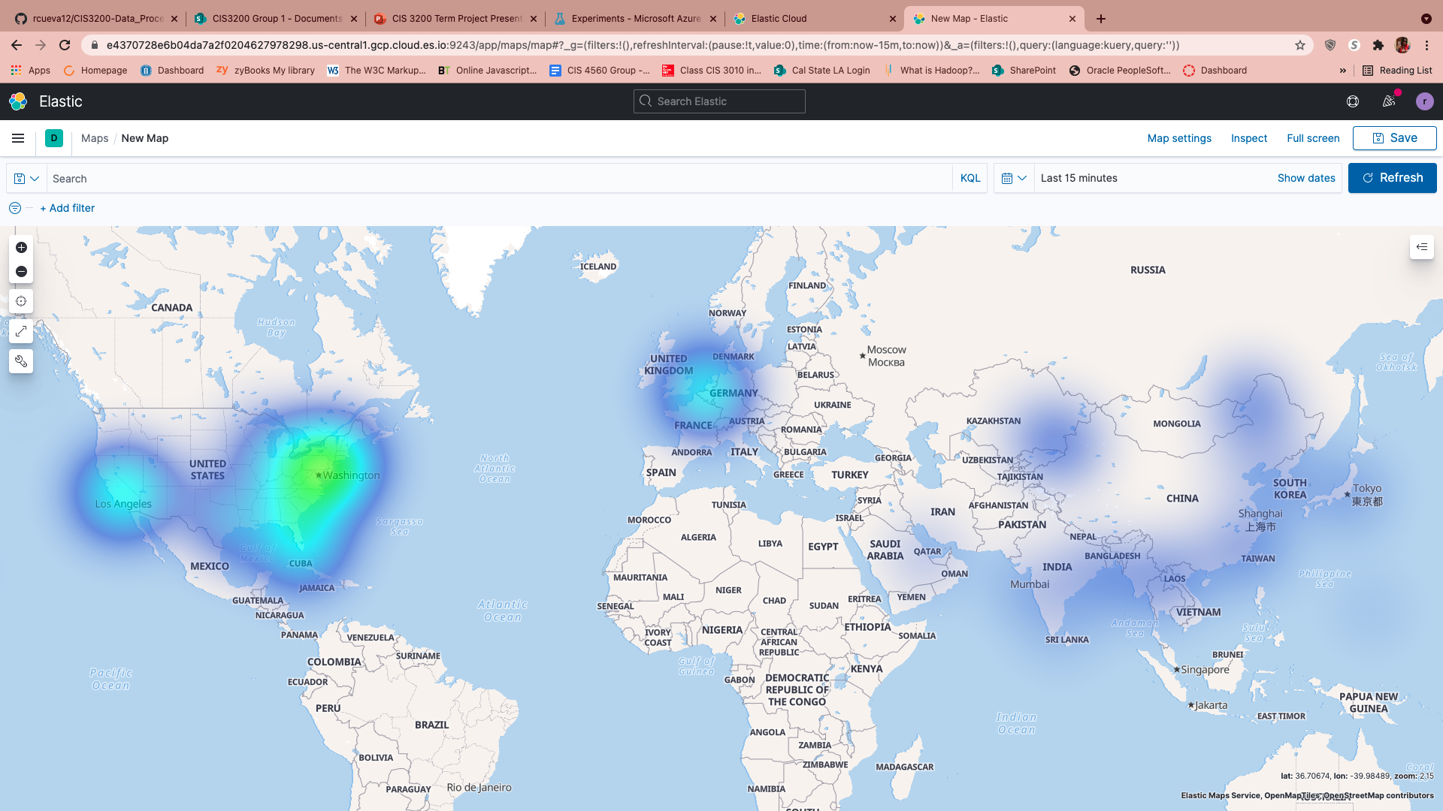
Top 50 Busiest US. and Foreign Airports

Slide 14
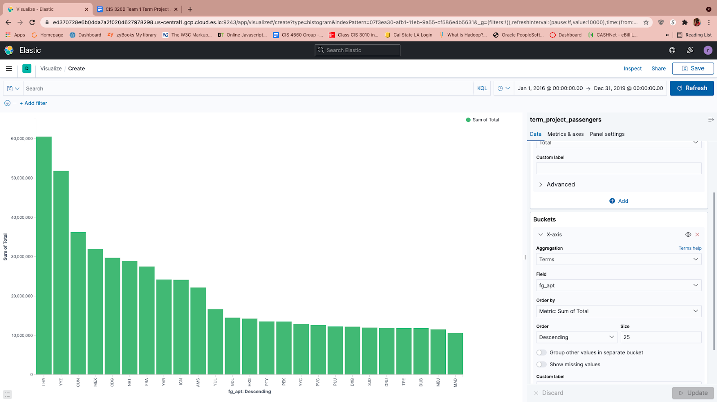
Drilldown Top 10 Fly To Foreign Airports 2016-2019 LHR-Heathrow, United Kingdom YYZ-Mississauga, Canada, CUN-Cancun, Mexico MEX-Mexico City, Mexico CDG-Paris, France NRT-Narita, Japan FRA-Frankfurt, Germany YVR-Vancouver, Canada ICN-Incheon, South Korea AMS-Amsterdam. Schiphol, Netherlands

Slide 15
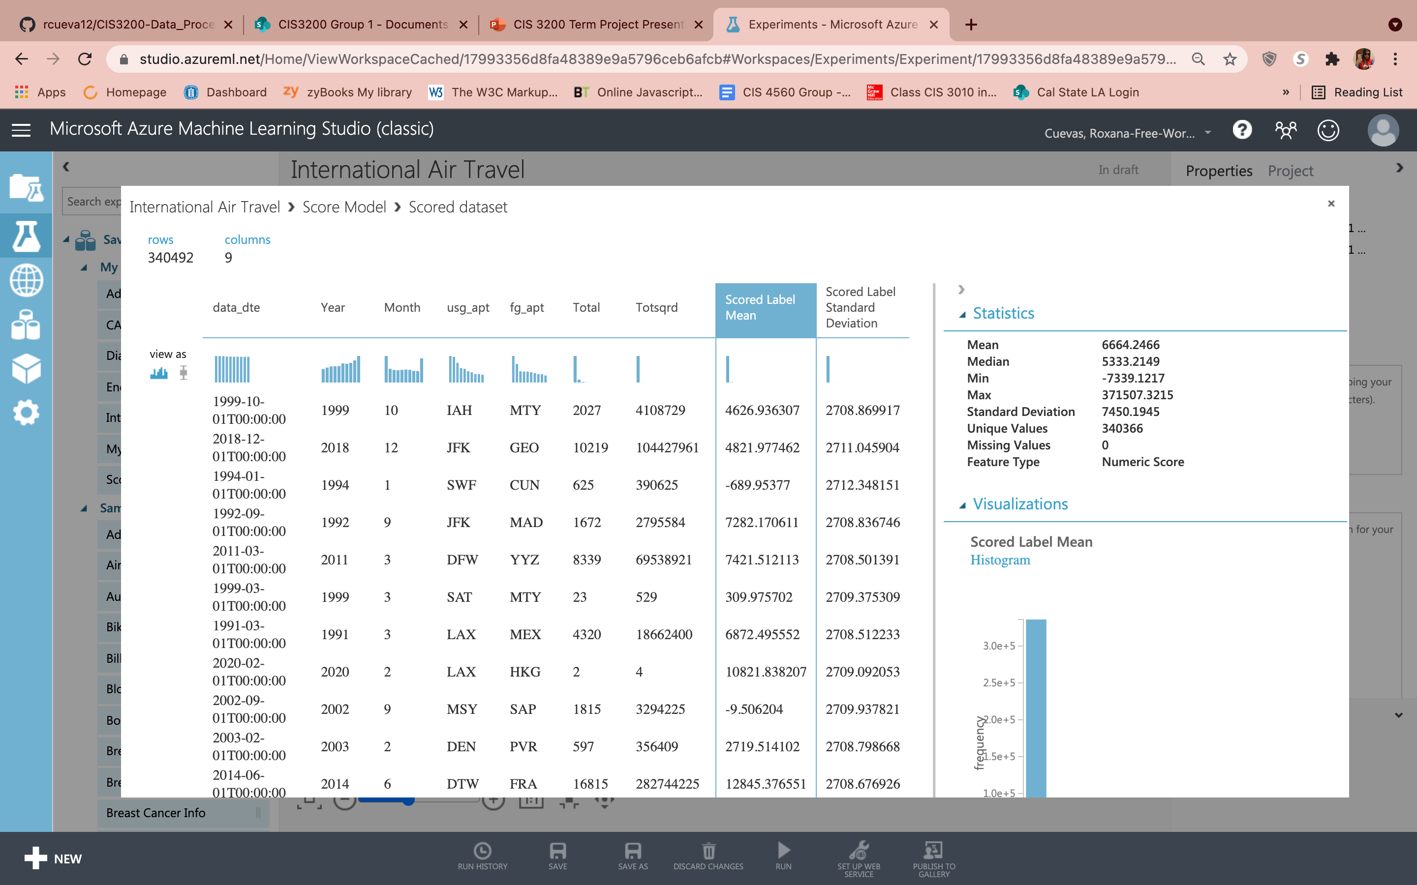
Predictive Analysis (Azure)

Slide 16
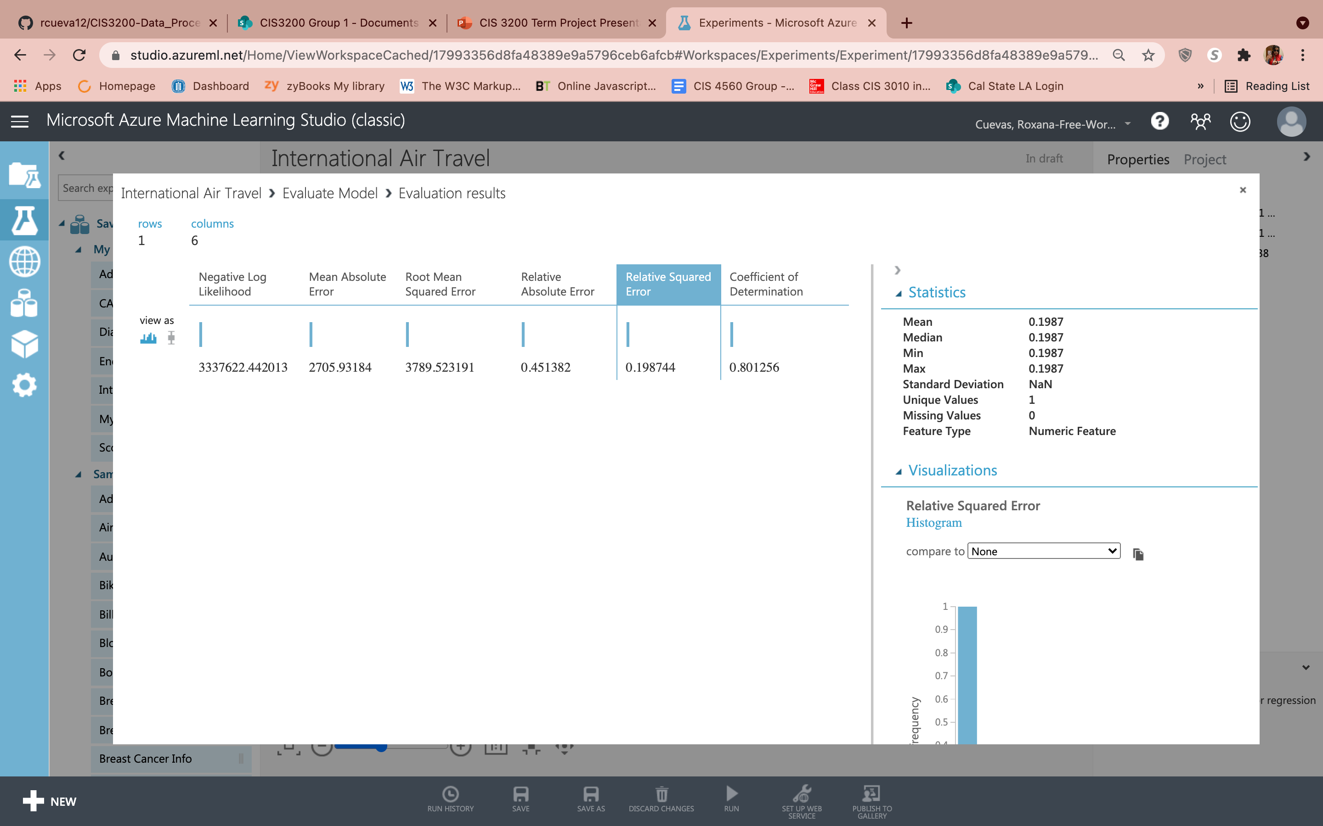
Predictive Analysis (Azure) continued

Slide 17
Resources
Data source: https://www.kaggle.com/parulpandey/us-international-air-traffic-data​
File Size 118MB
Github Repository: https://github.com/rcueva12/CIS3200-Data_Processing_Analytics/tree/main​
Elasticsearch Login: https://e4370728e6b04da7a2f0204627978298.us-central1.gcp.cloud.es.io:9243​
User: sa_admin​
Password: CalstateLA123
Azure Login: https://studio.azureml.net/Home/ViewWorkspaceCached/17993356d8fa48389e9a5796ceb6afcb#Workspaces/Experiments/Experiment/17993356d8fa48389e9a5796ceb6afcb.f-id.d100d11d87c74a629d4ebd2d3125ec11/ViewExperiment

Slide 18

Questions?

